Slide 1
Medical Cost Insurance Analysis Presentation
Leshmi Jayakumar

Slide 2
Project analysis slide 2
GOAL OF PROJECT
DATA
SUMMARY
METHODS
RESULT
CONCLUSION

Slide 3
Project analysis slide 3
GOAL
DATA
SUMMARY
METHODS
This project aims to create a relatively accurate prediction for the charges in medical insurance. Given the data, we will explore how different factors affect medical insurance charges and compile the most important feature.
The dataset which is used for the analysis is from Kaggle.
-Insurance.csv
The data has seven columns in that.
Dependent variable: Charges. The rest are independent variables: Age, Sex, BMI, Smoker, Region, Children.
The factors that help interpret the cost of insurance for an individual.
Which factors are correlated?
Checking the acceptability of the model using linear regression.
Data Cleaning
Data Visualization
Getting dummies
Log transformation.
Test-train split.
Model summary by OLS method.
Multi collinearity
Polynomial regression.

Slide 4
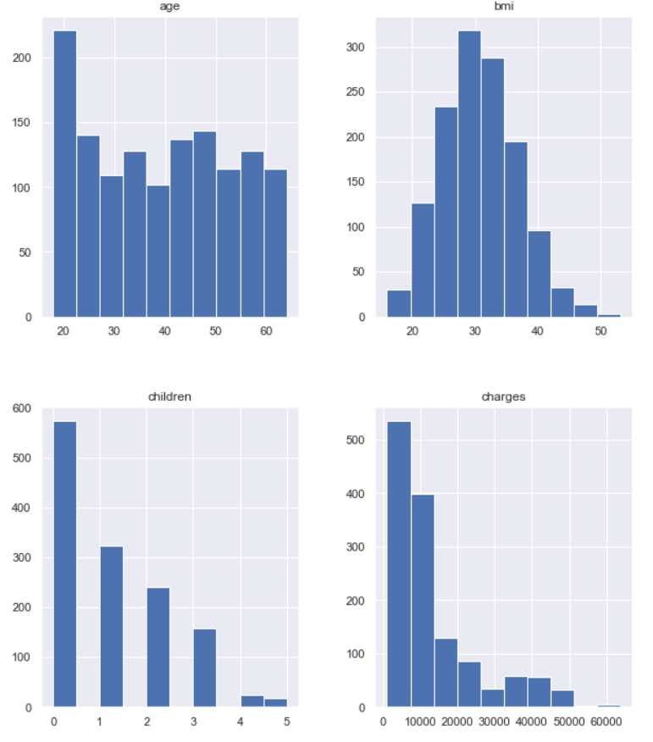
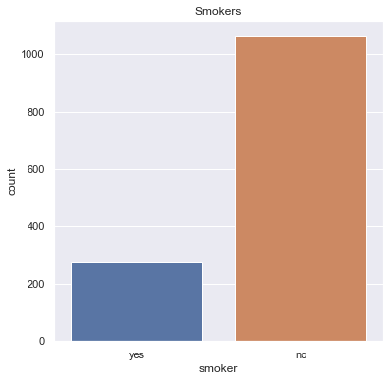
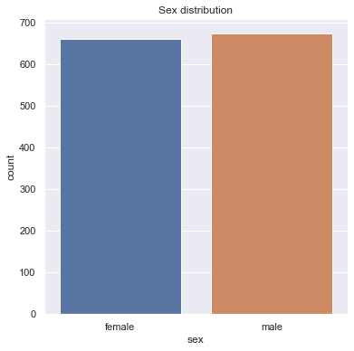
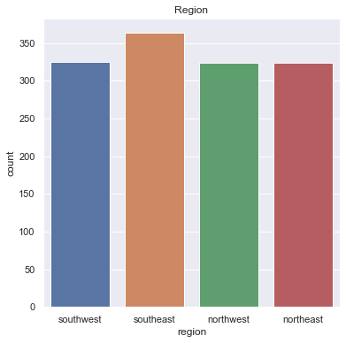
Data visualization

Slide 5
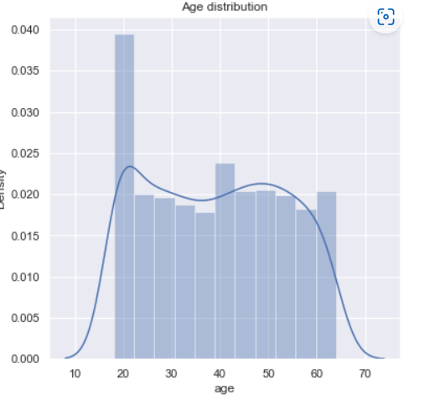
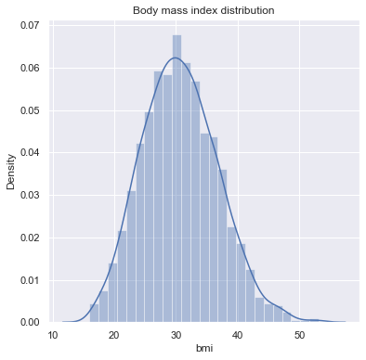
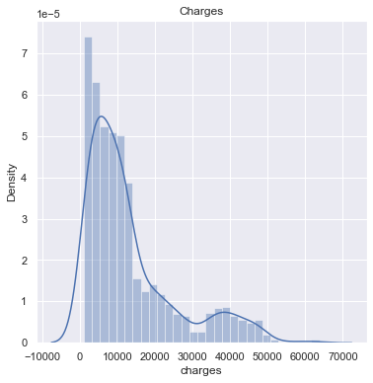

Slide 6
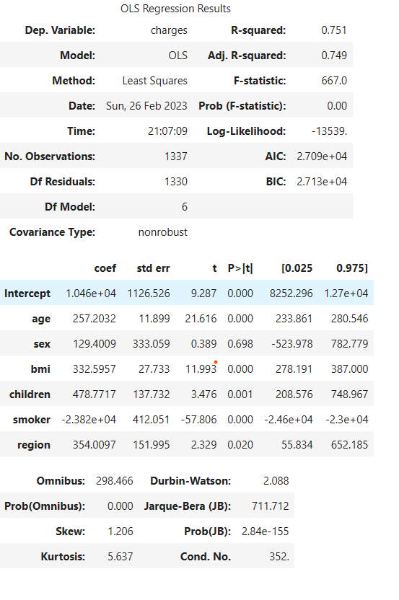
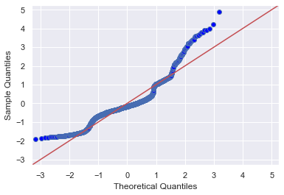
In the base model summary, the p-values for some variables are more than 0.05,need to get dummies and drop some variables.
Q-Q plot

Slide 7
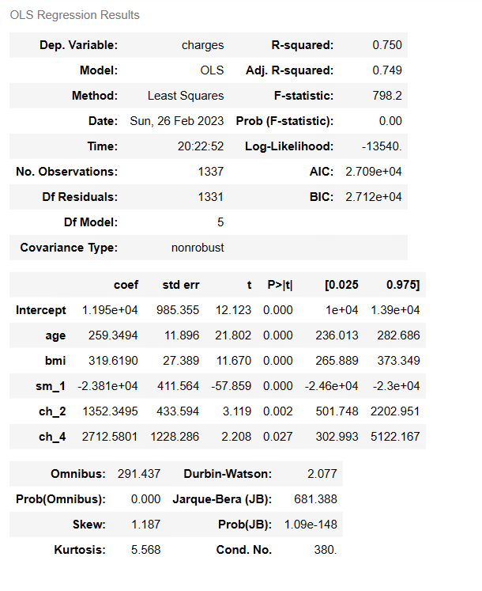
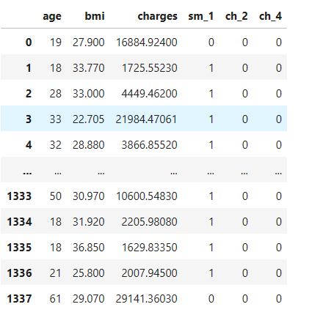
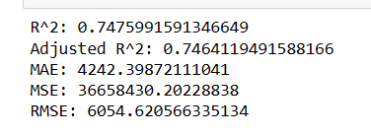
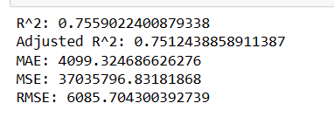
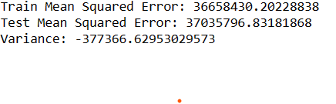
After creating dummies and dropping the variables with p-values>0.05, performed model summary using the OLS model, test and train split and checked the r-square value, Adjusted-r-square, MSE, MAE, RMSE.
Base model
Train Split
Test Split

Slide 8
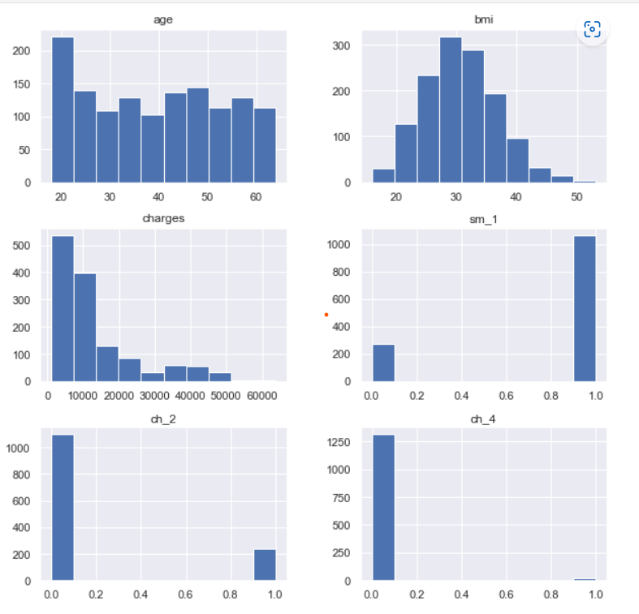
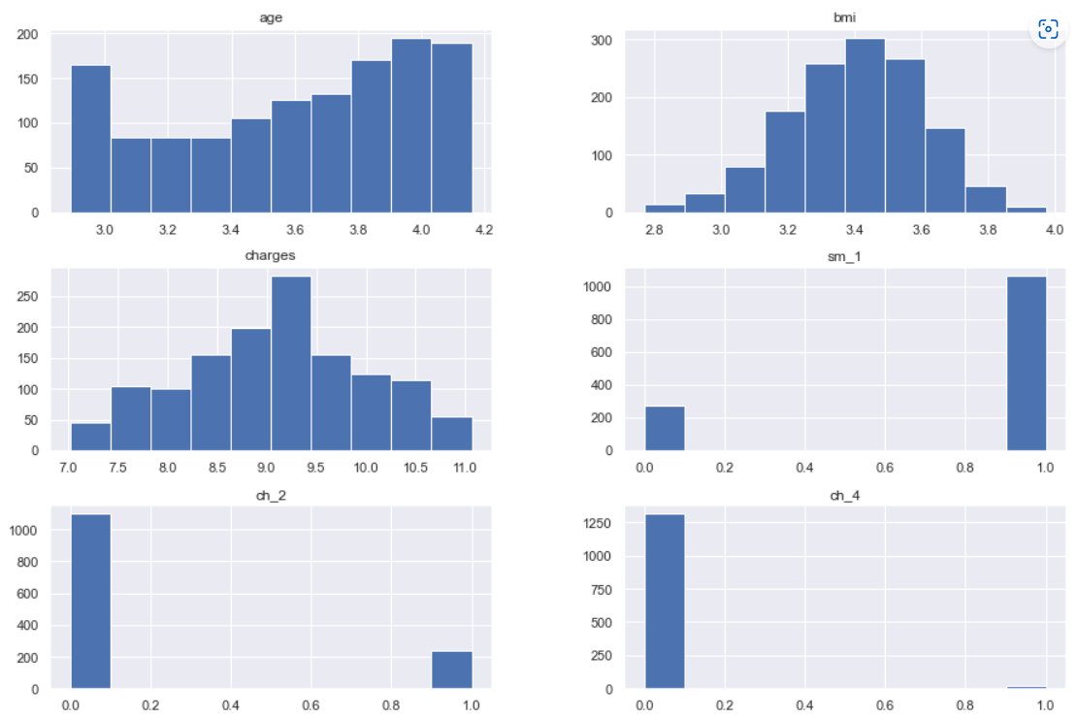
Iteration1-Log transform
Before log transform
After log transform

Slide 9
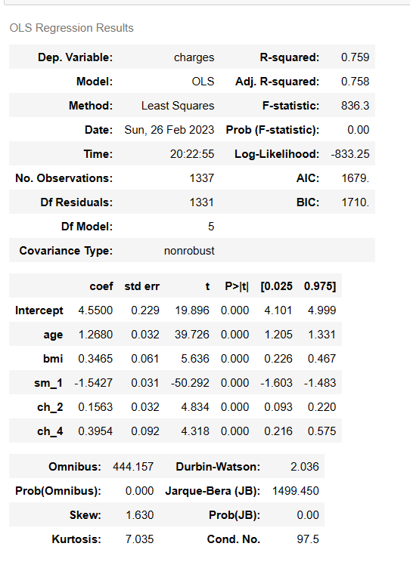
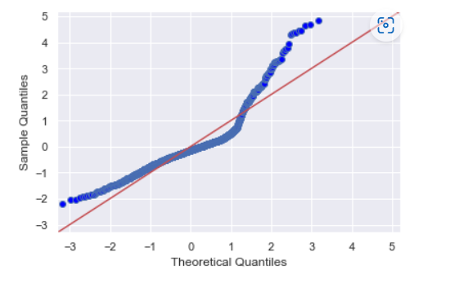
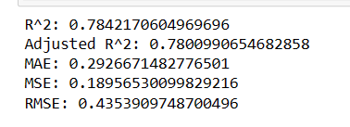
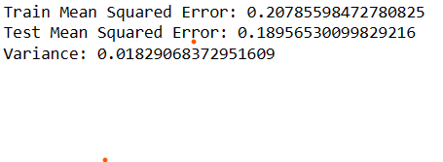
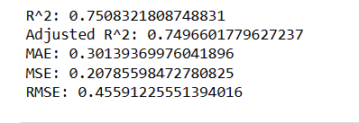
Performed model summary using OLS model, test and train split and checked the r-square value, Adjusted-r-square, MSE, MAE, RMSE
Test split
Train split

Slide 10
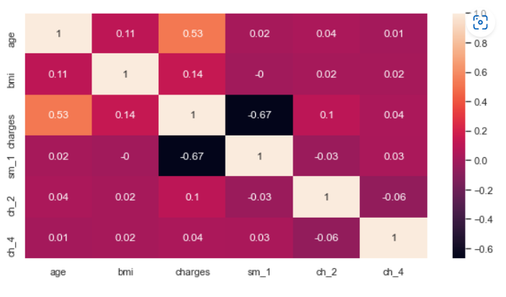
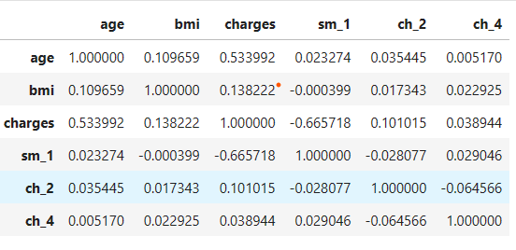
Correlation

Slide 11
Project analysis slide 8
Conclusion
The factors that help interpret the cost of insurance for an individual.
Age
BMI
Which factors are correlated?
Age is highly correlated with the charge of the insurance.
Checking the acceptability of the model using linear regression.
In the base model, the R-square value is 75%, and in the Iteration 1 model, the R-square value is 76%.
The p-value < 0.05 for all five variables.
The difference in MSE is less between train tests, so it is under-fitted.

Slide 12
Thank You

